Slide 1
Mood-Mixer: Discover Music for Every Mood
"Quickly find Spotify playlists that match your current mood — happy, sad, calm, angry, or euphoric!"
Team: Landon Bailey

Slide 2
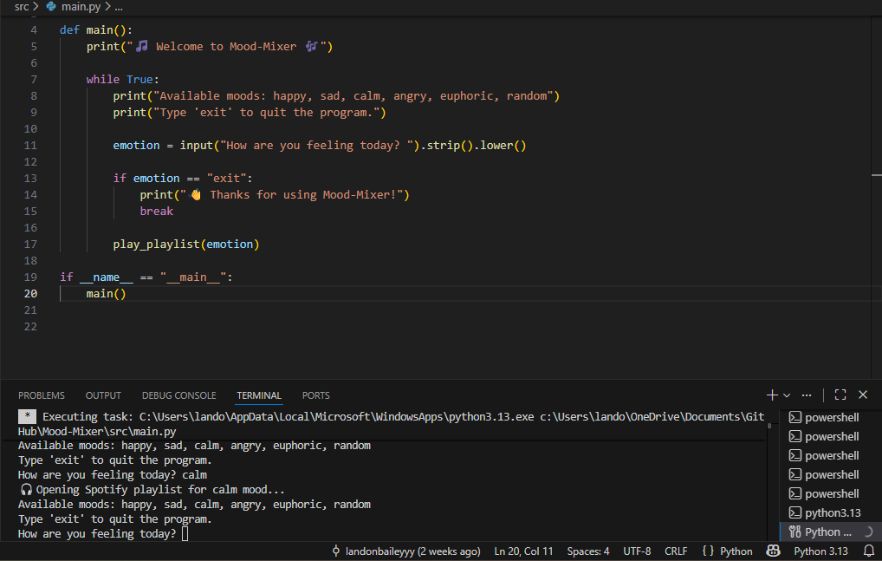

Mood-Mixer: Discover Music for Every Mood
Quickly find Spotify playlists that match your current mood — happy, sad, calm, angry, or euphoric!
Team: Landon Bailey
Step 1:
Step 2:
User selects their current mood from the program, which accepts multiple moods, or a random choice.
The program opens a Spotify playlist that matches the selected mood, allowing the user to start listening immediately.

